Slide 1
Programmazione Cl.B
Andrea Piroddi
Dipartimento di Informatica, Scienza e Ingegneria

Slide 2
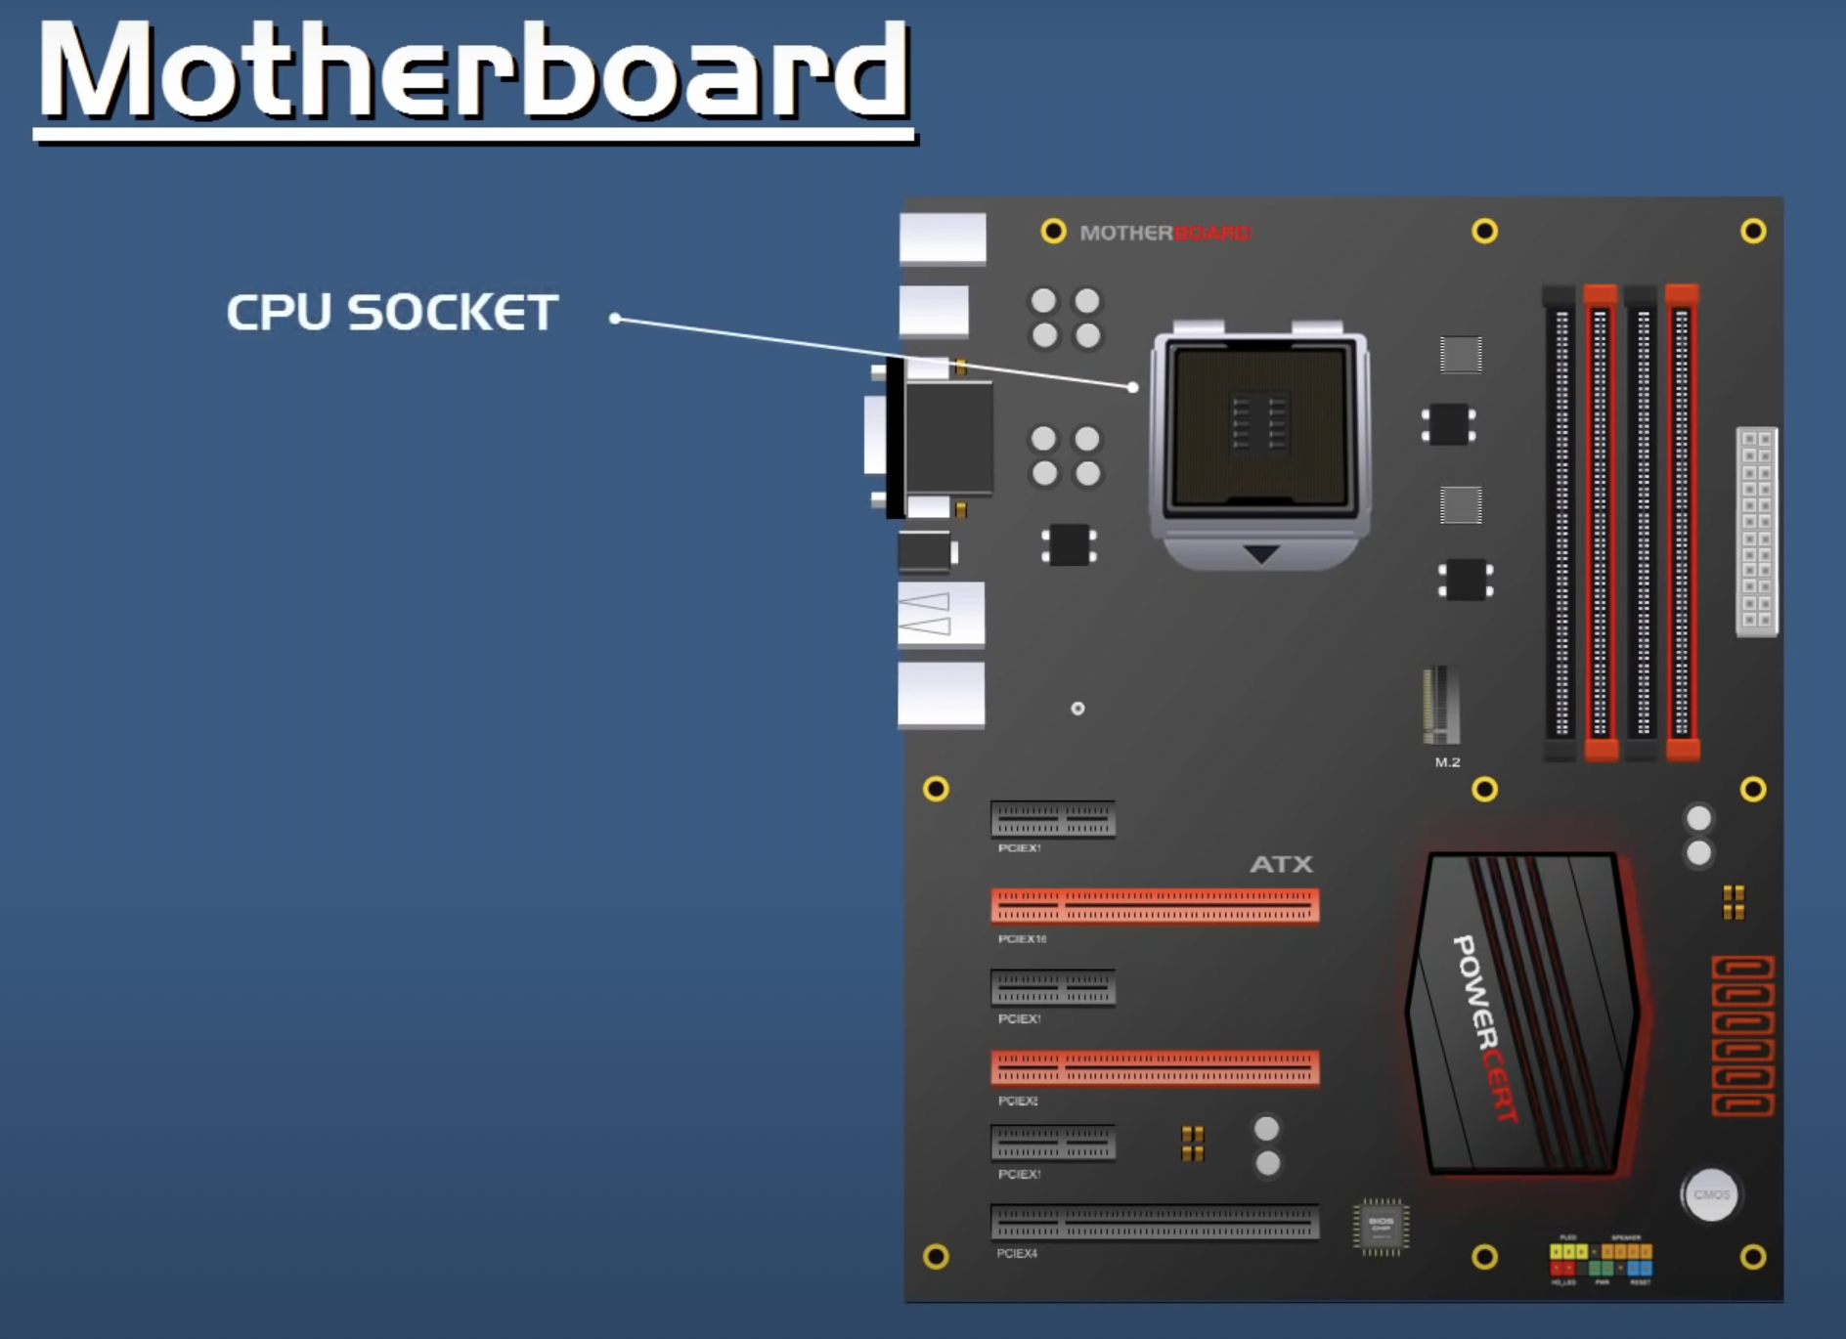
MOTHERBOARD

Slide 3
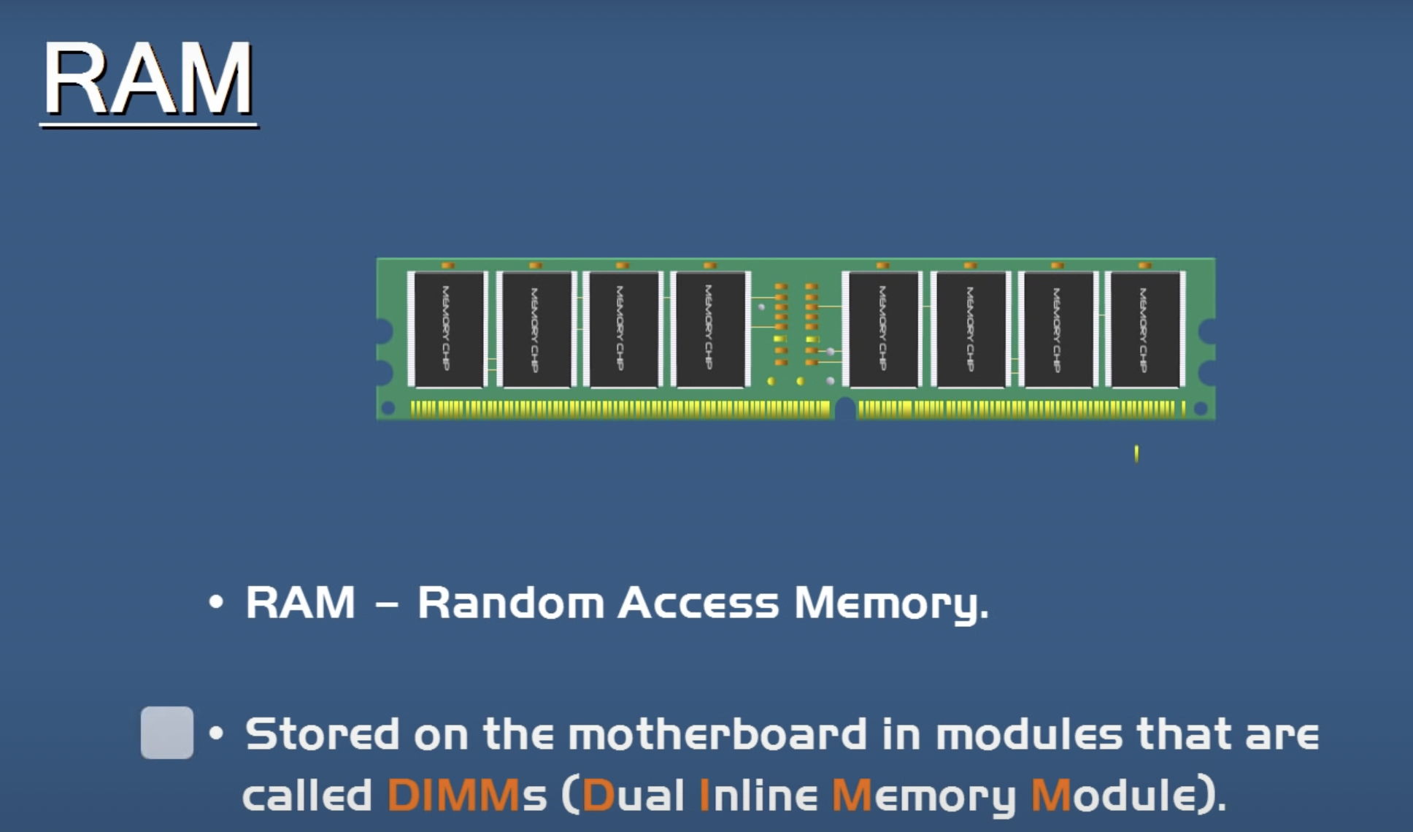
RAM – How does it work?

Slide 4
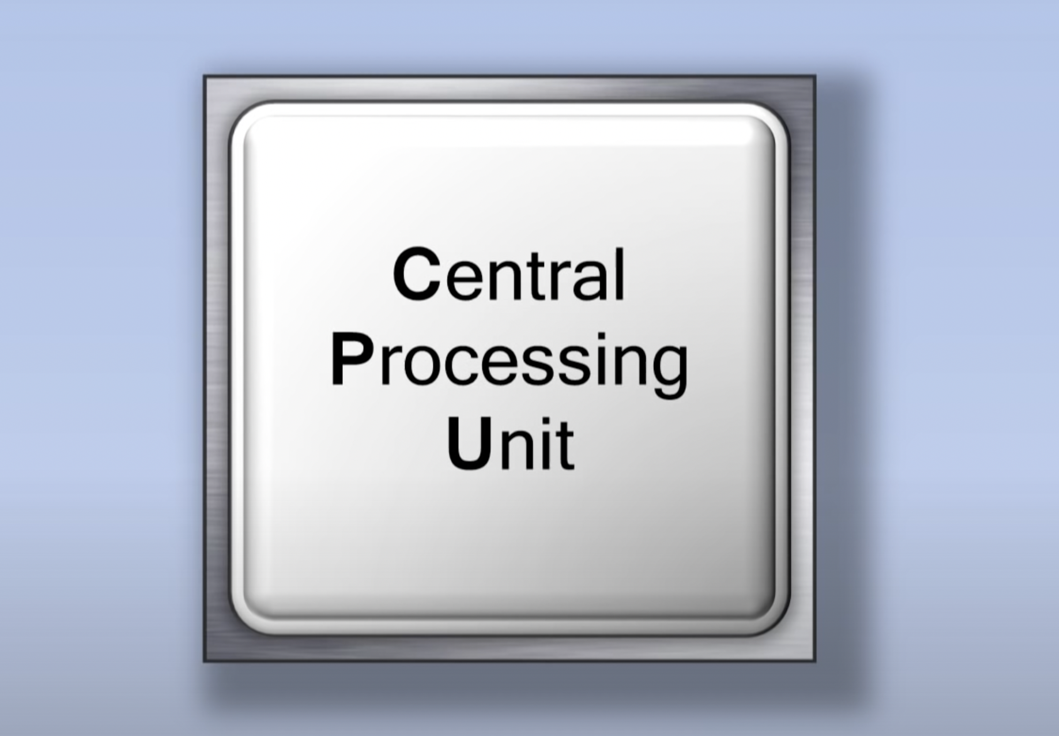
CPU – How does it work?

Slide 5
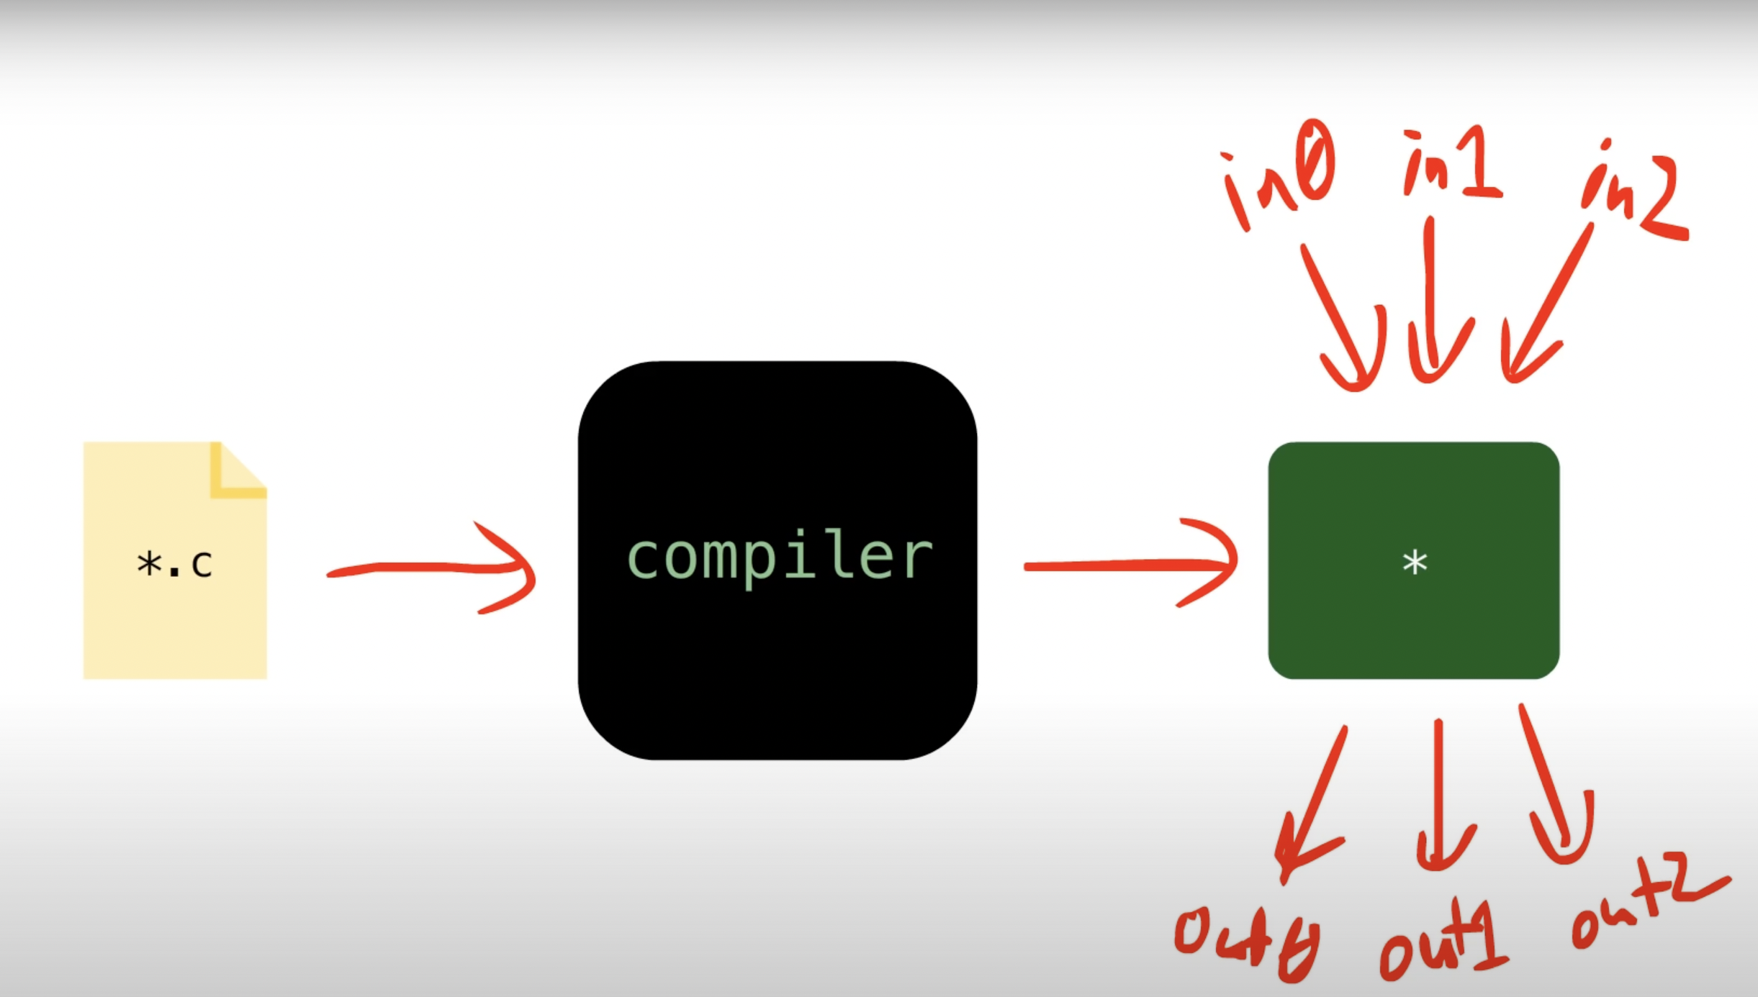
Compiler – How does it work?

Slide 6
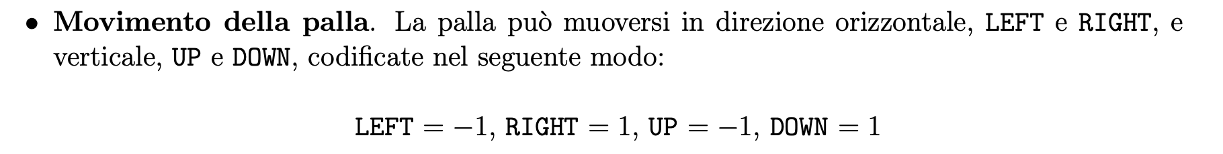
Elaborato 6 - Chiarimenti
#include "game.h"
#include <stdio.h>
#define LEFT -1
#define RIGHT 1
#define UP …
#define DOWN …
#define SHIFT_COL(b,p,n) (…)
#define SAME_ROW(b,p,len) (…)
#define TOP_ROW(b,p) ((b).y == (p).y-1)
#define BOT_ROW(b,p,len) ((b).y == (p).y+len)

Slide 7
Elaborato 6
#define PAD1_TOP_BORDER_TOUCH(G) ((SHIFT_COL(G.b,G.p1,-1) || SHIFT_COL(G.b,G.p1,0) || SHIFT_COL(G.b,G.p1,1)) && TOP_ROW(G.b,G.p1))
#define PAD1_BOT_BORDER_TOUCH(G) (…)
#define PAD2_TOP_BORDER_TOUCH(G) (…)
#define PAD2_BOT_BORDER_TOUCH(G) (…)
#define PAD1_FULL_TOUCH(G) (SHIFT_COL(G.b,G.p1,1) && SAME_ROW(G.b,G.p1,G.pad_len))
#define PAD2_FULL_TOUCH(G) (…)
#define PAD1_TOUCH(G) (PAD1_TOP_BORDER_TOUCH(G) || PAD1_BOT_BORDER_TOUCH(G) || PAD1_FULL_TOUCH(G))
#define PAD2_TOUCH(G) (…)
#define PAD_TOP_BORDER_TOUCH(G) (PAD1_TOP_BORDER_TOUCH(G) || PAD2_TOP_BORDER_TOUCH(G))
#define PAD_BOT_BORDER_TOUCH(G) (…)
#define BALL_TOP_BORDER_TOUCH(G) ((G).b.y == 0)
#define BALL_BOT_BORDER_TOUCH(G) (…)

Slide 8
Elaborato 6
#define BALL_LEFT_BORDER_TOUCH(G) ((G).b.x == 0)
#define BALL_RIGHT_BORDER_TOUCH(G) ((G).b.x == (G).width-1)
#define BALL_BORDER_TOUCH(G) (BALL_LEFT_BORDER_TOUCH(G) || BALL_RIGHT_BORDER_TOUCH(G))
struct paddle {
int x;
int y;
};
struct ball {
int x;
int y;
int v; // vertical direction
int h; // horizontal direction
};

Slide 9
Elaborato 6
struct game {
unsigned int score1;
unsigned int score2;
int pad_len;
int width;
int height;
int starting_ball_x;
int starting_ball_y;
struct ball b;
struct paddle p1;
struct paddle p2;
};

Slide 10
Elaborato 6
static struct game G;
void setup_game(int height, int width,
struct position ball_pos, struct position ball_dir,
struct position pad1_pos, struct position pad2_pos, int pad_len) {
G.starting_ball_x = ball_pos.x;
G.starting_ball_y = …;
G.score1 = G.score2 = 0;
G.width = width;
G.height = height;
G.pad_len = pad_len;

Slide 11
Elaborato 6
G.p1.x = pad1_pos.x;
G.p1.y = pad1_pos.y;
G.p2.x = …;
G.p2.y = …;
G.b.x = ball_pos.x;
G.b.y = …;
G.b.h = …;
G.b.v = …;
}

Slide 12
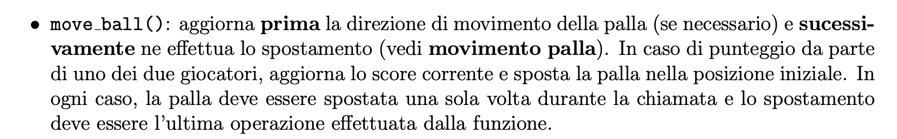
Elaborato 6
void move_ball() {
if(BALL_BORDER_TOUCH(G)) {
if(BALL_LEFT_BORDER_TOUCH(G)) G.score2++;
else G.score1++;
G.b.x = G.starting_ball_x;
G.b.y = …;
} else {
// PAD1 TOUCH
if(PAD1_TOUCH(G)) G.b.h = RIGHT;
// PAD2 TOUCH
if(PAD2_TOUCH(G)) G.b.h =…;

Slide 13
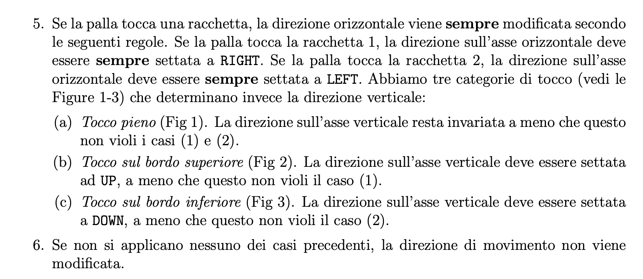
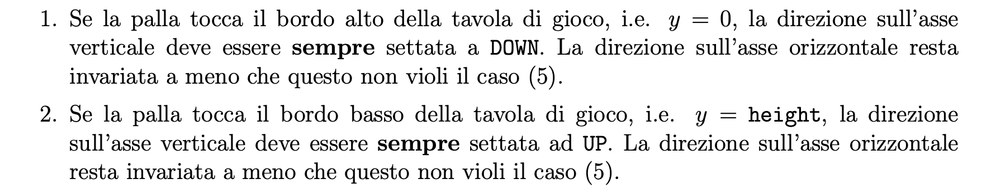
Elaborato 6
// PAD BORDER TOUCH
if(PAD_BOT_BORDER_TOUCH(G)) G.b.v = DOWN;
else if(…);
// TOP BORDER TOUCH
if(BALL_TOP_BORDER_TOUCH(G)) G.b.v = DOWN;
// BOTTOM BORDER TOUCH
…
// UPDATE POSITION
G.b.x += G.b.h;
G.b.y += …;
}
}

Slide 14
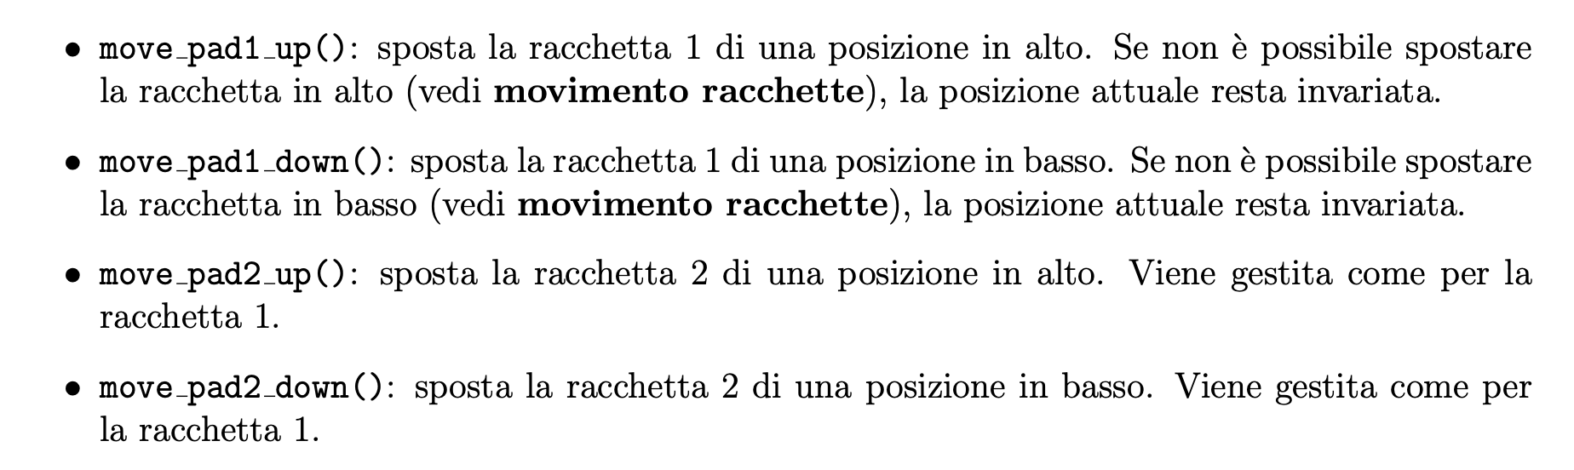
Elaborato 6
void move_pad1_up(void) {
if(G.p1.y > 0 && !PAD1_TOP_BORDER_TOUCH(G)) G.p1.y--;
}
void move_pad2_up(void) {
if(…) G.p2.y--;
}
void move_pad1_down(void) {
if(…) G.p1.y++;
}
void move_pad2_down(void) {
if(…) G.p2.y++;
}

Slide 15
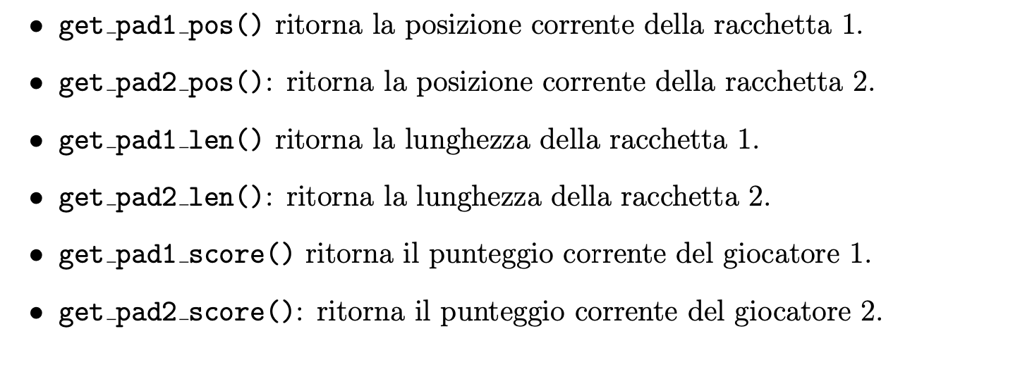
Elaborato 6
unsigned int get_pad1_score(void) {
return G.score1;
}
unsigned int get_pad2_score(void) {
…;
}
struct position get_ball_pos(void) {
struct position p;
p.x = G.b.x;
…;
…;
}

Slide 16
Elaborato 6
struct position get_pad1_pos(void) {
struct position p;
p.x = G.p1.x;
p.y = …;
return p;
}
struct position get_pad2_pos(void) {
struct position p;
…;
}
unsigned int get_pad_len(void) {
return G.pad_len;
}

